Slide 1
IEEE
3D Mapping using Image Processing
Done By:
Saikumar Dande
Chandravaran Kunjeti

Slide 2
TABLE OF CONTENTS
1.
3.
4.
2.
INTRODUCTION TO STEREO
RESULTS OBTAINED
Here we are going to give a brief introduction to stereo vision
So far the algorithms and results obtained will be explained here
TIMELINE AND FUTURE WORK
METHODOLOGY APPLIED
Here we are going to describe the method of progress that is going to be done in the future
Here we described the different methods that we used

Slide 3
PROJECT GOALS
Software
Hardware
We have implemented algorithms from scratch and figuring out the best algorithm to use and reducing the latency to compute the depth images
We would like to implement what we have implemented on images to that of real time feed

Slide 4
1
INTRODUCTION
TO STEREO

Slide 5
METHODS TO OBTAIN DEPTH
STEREO
This works on the principle of reconstruction of an image using 2 images
LIDAR
ONE SHOT STRUCTURED LIGHT
Uses light transmitted to calculate the distance
Where methods of triangulation is used to obtain the depth
IR
MOTION BASED
Uses a IR Transmitter and receiver to determine the depth
Depth can be calculated based on the movement of the camera

Slide 6
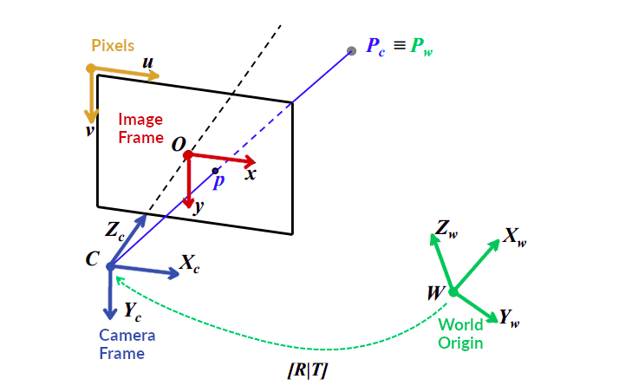
Camera Calibration
If we want understand the point in an Image we need to know what transforms are involved in the process, there are many types of parameters which are as follows
Extrinsic parameters
- Rotation matrix
- Translation matrix
Intrinsic parameters
-Intrinsic matrix
-Focal length
-Optical centre

Slide 7
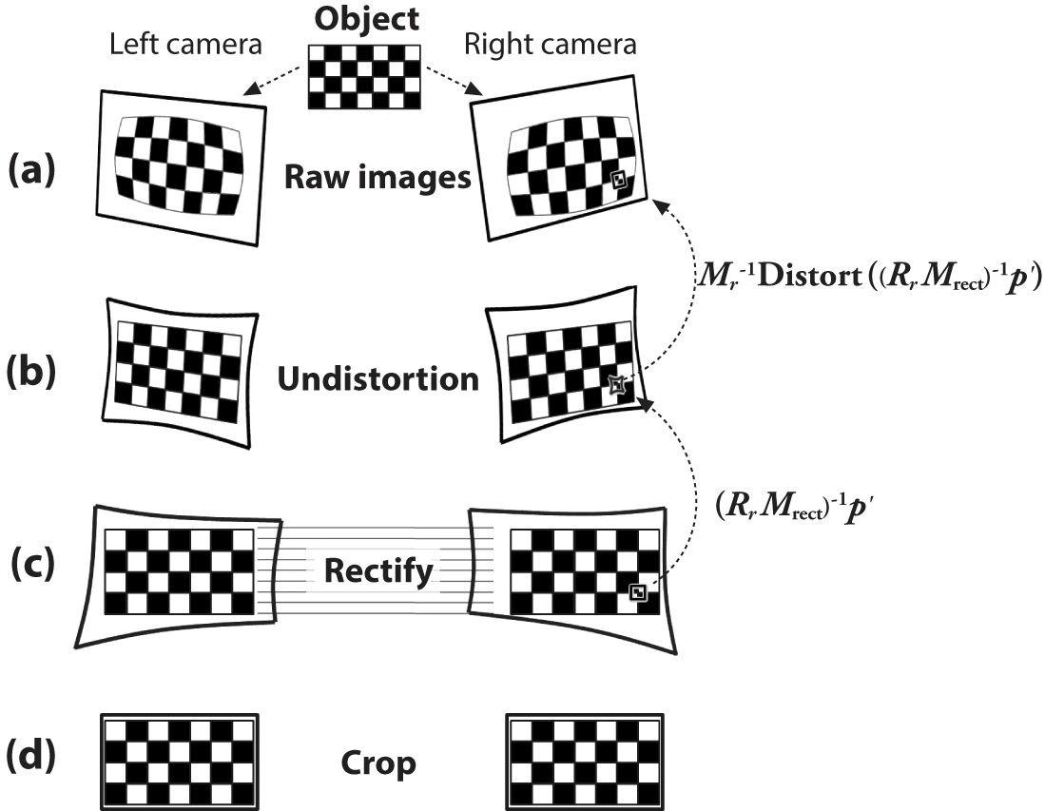
Image Rectification
Stereo camera calibration info is used for rectification.
Rectification process
Removes lens distortion.
Turns the stereo pair into standard form where images are perfectly aligned horizontally.

Slide 8
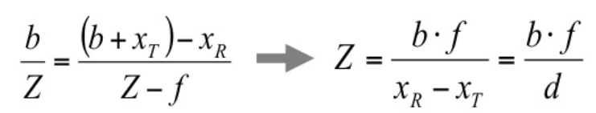
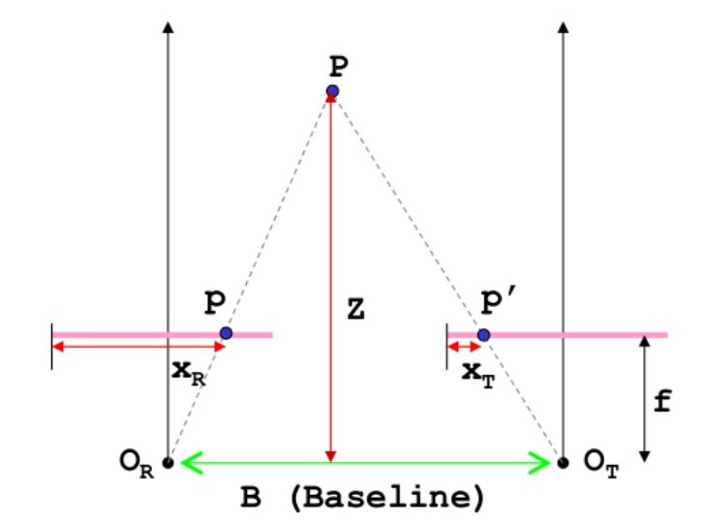
Disparity
Disparity = X_{R}-X_{T}

Slide 9
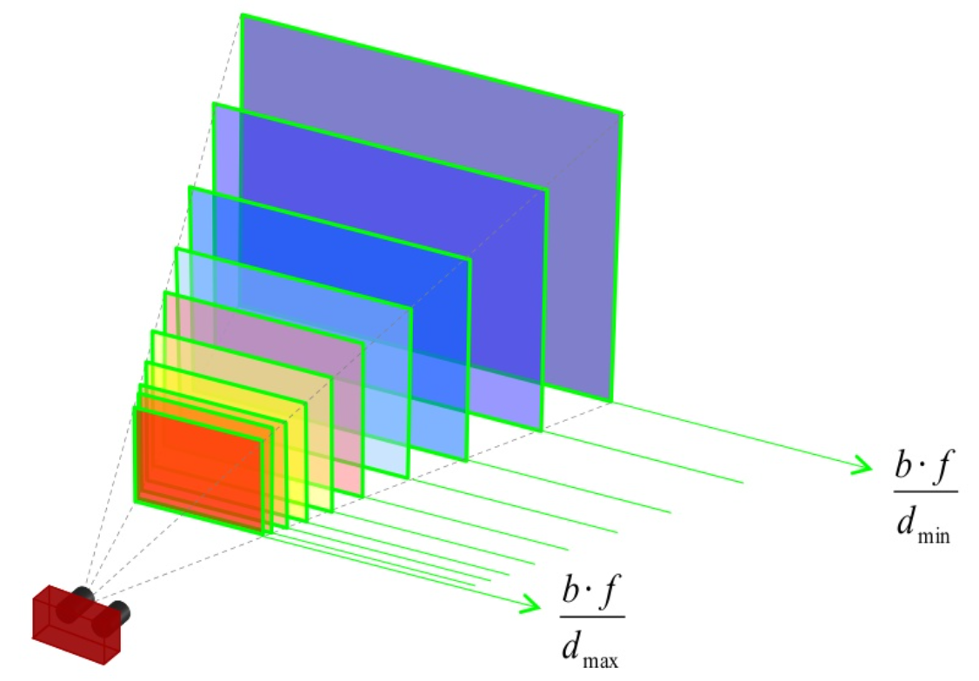
Depth
Depth = Base_length*Focal_length/Disparity
Base_length = Distance between left and right camera

Slide 10
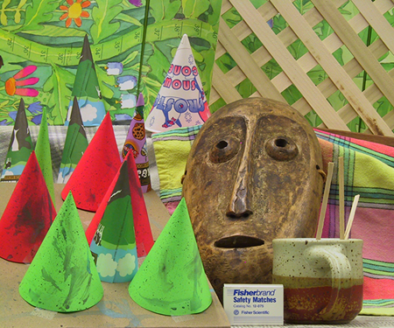
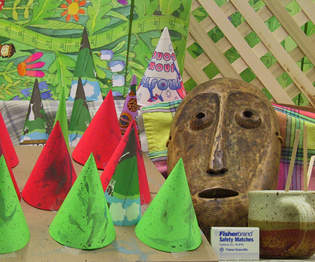
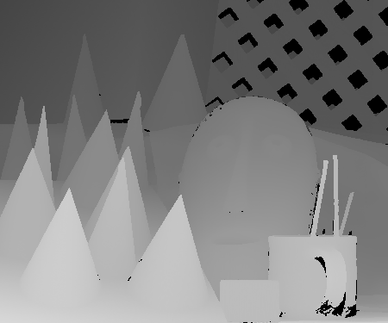
Dataset
Year 2001 Vision Middlebury dataset was taken.
Each image set consists of 9 images(im0.ppm - im8.ppm) and ground truth disparity maps for images 2 and 6.
We used im2.ppm as left image and im6.ppm as right image to calculate disparity map.
Ground truth disparity map consists of 64 levels of disparity (0-63).

Slide 11
2
METHODOLOGY
APPLIED

Slide 12
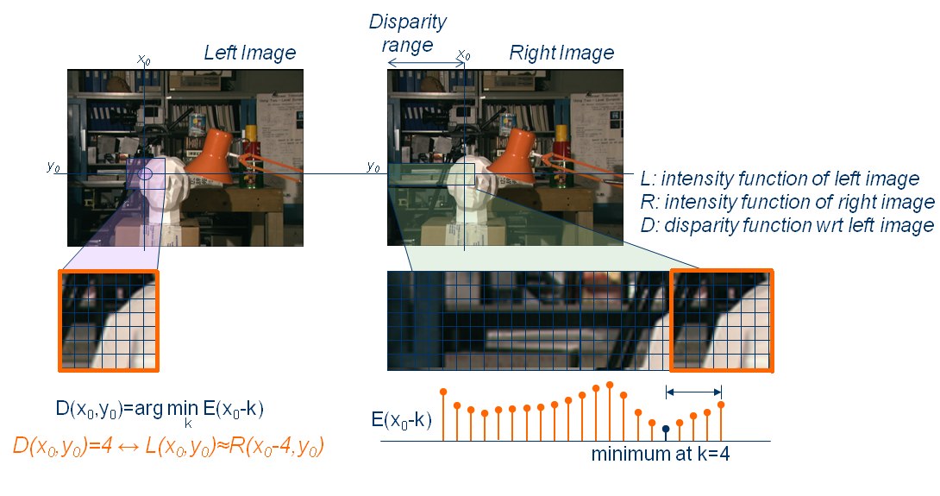
Block Matching (BM)

Slide 13
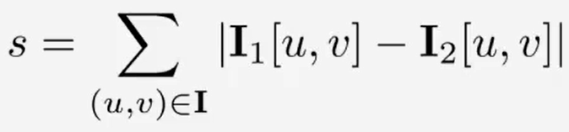
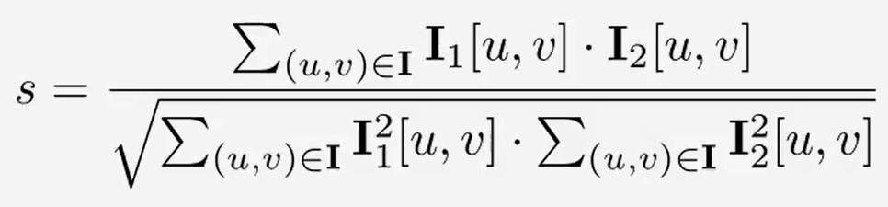
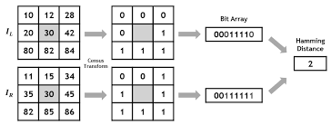
Sum of Absolute Difference(SAD)
Normalized correlation(NC)
Census Transform(CT)

Slide 14
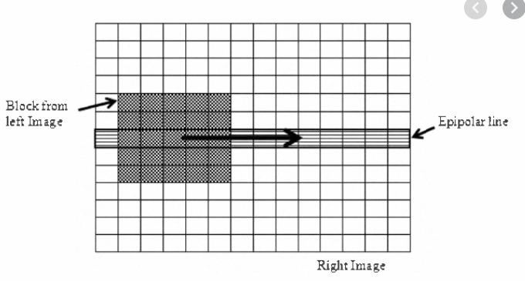
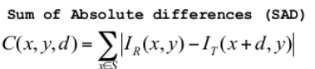
Sum of Absolute Differences (SAD)

Slide 15
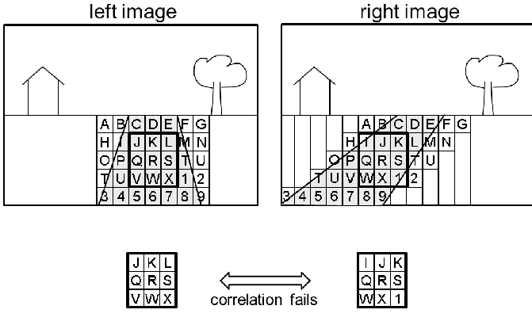
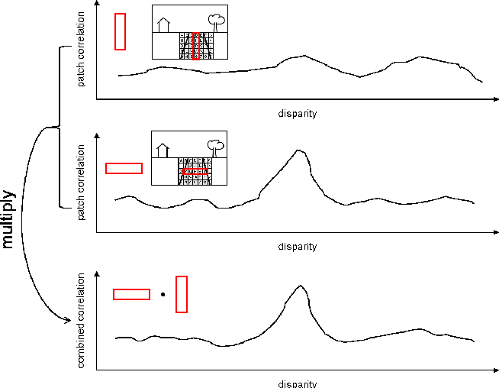
Multi Block Matching (MBM)
Reason to use Multi Block Matching

Slide 16
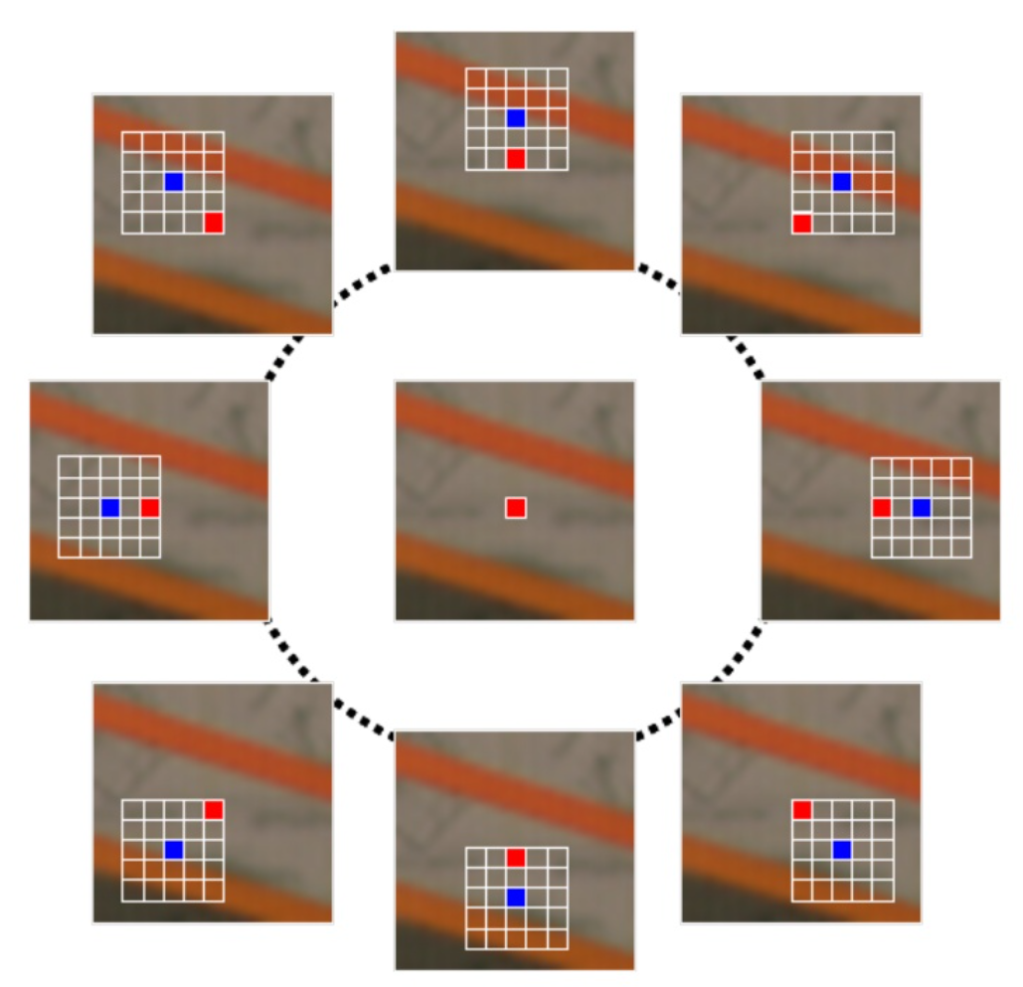
Locally Consistent Disparity Map Generation

Slide 17
3
RESULTS OBTAINED

Slide 18
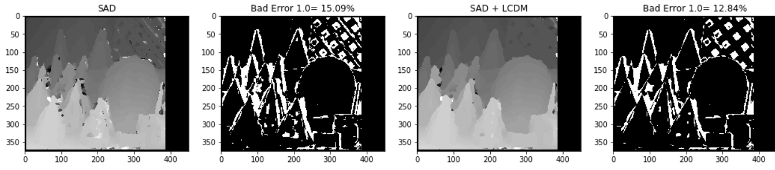
Results - SAD
For Single Block Matching and LCDM we used a block size of 11x11.

Slide 19
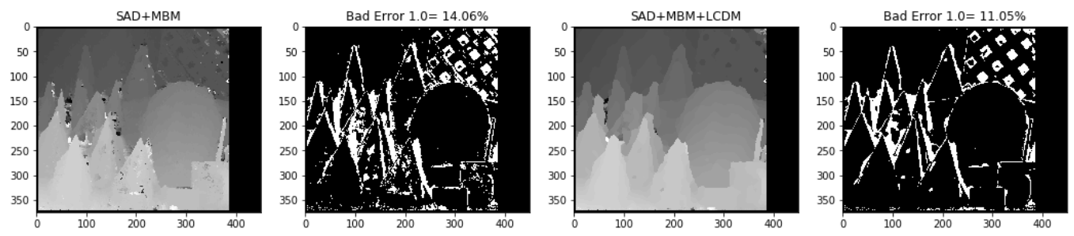
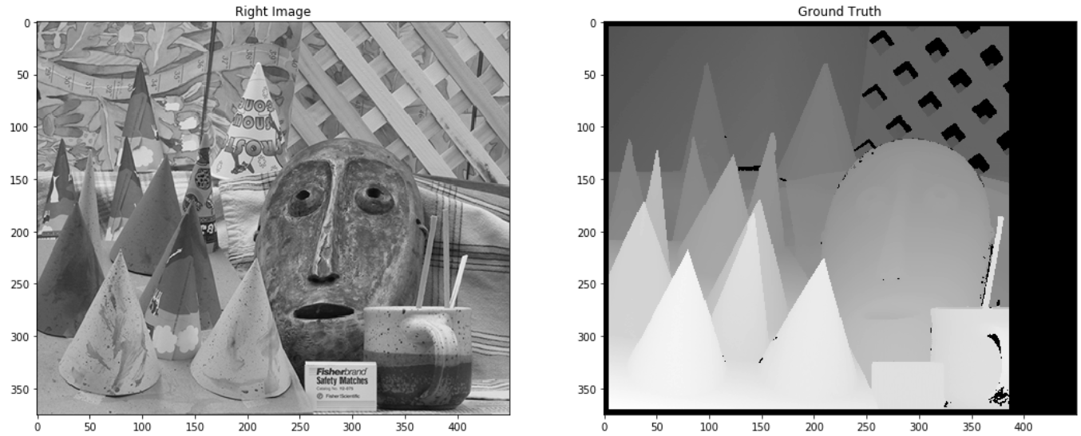
For Multi Block Matching, following combination of block sizes is used for better results:
min(1x61, 61x1), 11x11, 3x3

Slide 20
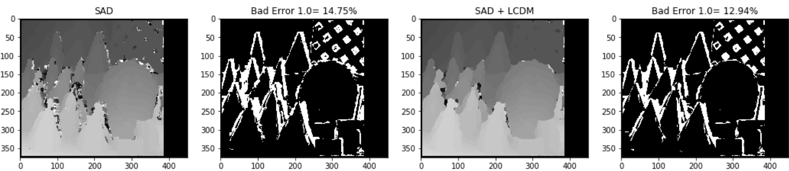
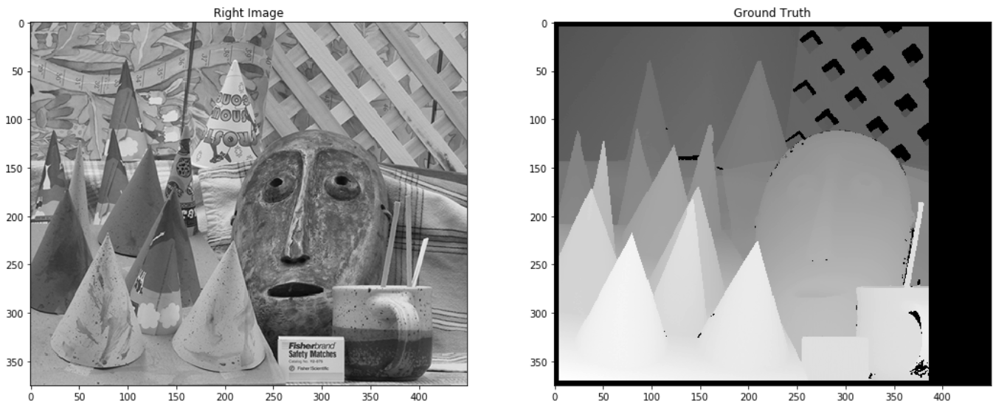
Results-Normalised Correlation
Block size = 11x11

Slide 21
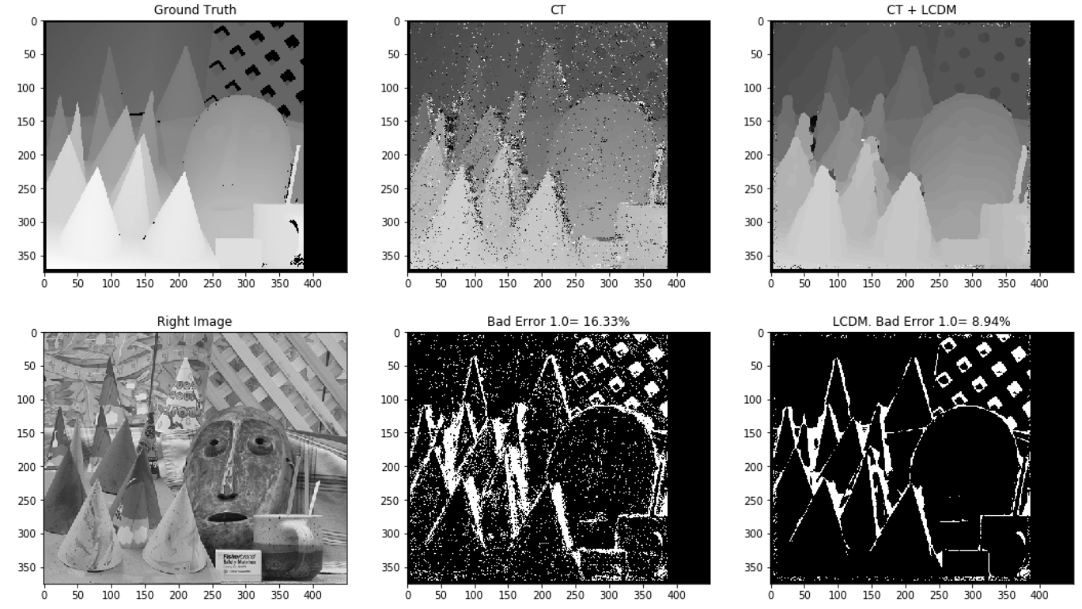
Results-Census Transform

Slide 22
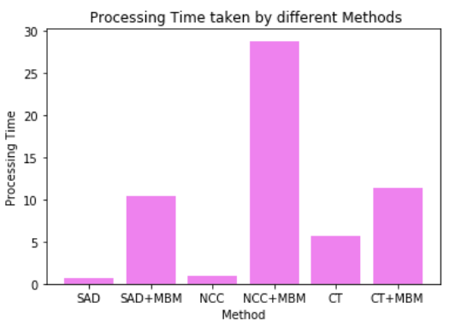
Processing time for different Methods
Processing time taken by different methods to find disparity Map for Cones dataset

Slide 23


Slide 24
Results
Methods | BM | BM+LCDM | MBM | MBM+LCDM
SAD | 15.09 | 12.84 | 14.06 | 11.05
NCC | 14.75 | 12.94 | 21.61 | 18.79
Census Transform | 16.33 | 8.94 | 42.78 | 10.22

Slide 25
References
L. Ma, J. Li, J. Ma and H. Zhang, "A Modified Census Transform Based on the Neighborhood Information for Stereo Matching Algorithm," 2013 Seventh International Conference on Image and Graphics, Qingdao, China, 2013, pp. 533-538, doi: 10.1109/ICIG.2013.113.
N. Einecke and J. Eggert, "A multi-block-matching approach for stereo," 2015 IEEE Intelligent Vehicles Symposium (IV), Seoul, Korea (South), 2015, pp. 585-592, doi: 10.1109/IVS.2015.7225748.
Yang, Q., Yang, R., Davis, J., & Nister, D. (2007). Spatial-Depth Super Resolution for Range Images. 2007 IEEE Conference on Computer Vision and Pattern Recognition. doi:10.1109/cvpr.2007.383211

Slide 26
Other Links
https://towardsdatascience.com/structure-from-motion-311c0cb50e8d
https://medium.com/@omar.ps16/stereo-3d-reconstruction-with-opencv-using-an-iphone-camera-part-iii-95460d3eddf0

Slide 27
4
TIMELINE AND
FUTURE WORK

Slide 28
TIMELINE
Milestone 1
Milestone 3
We aim to complete the coding for the Stereo camera
Stitching the different Camera Images to obtain 3D Map
Milestone 2
Camera Calibration for the obtained camera and implementation of algo

Slide 29
Papers for future Work
Links for future Work
Yang, Y., Qiu, F., Li, H., Zhang, L., Wang, M.-L., & Fu, M.-Y. (2018). Large-scale 3D Semantic Mapping Using Stereo Vision. International Journal of Automation and Computing, 15(2), 194–206. doi:10.1007/s11633-018-1118-y
H. Hirschmuller, "Stereo Processing by Semiglobal Matching and Mutual Information," in IEEE Transactions on Pattern Analysis and Machine Intelligence, vol. 30, no. 2, pp. 328-341, Feb. 2008, doi: 10.1109/TPAMI.2007.1166.
T. Kanade and M. Okutomi, "A stereo matching algorithm with an adaptive window: theory and experiment," in IEEE Transactions on Pattern Analysis and Machine Intelligence, vol. 16, no. 9, pp. 920-932, Sept. 1994, doi: 10.1109/34.310690.
http://pointclouds.org/documentation/tutorials/#
http://www.open3d.org/docs/release/tutorial/reconstruction_system/index.html

Slide 30
THANKS!
Roshan Rangarajan
Saikumar Dande
Chandravaran Kunjeti
DO YOU HAVE ANY QUESTION?

